Slide 1
NE 591: Advanced Reactor Materials
Fall 2021
Dr. Benjamin Beeler

Slide 2
advanced cladding

Slide 3
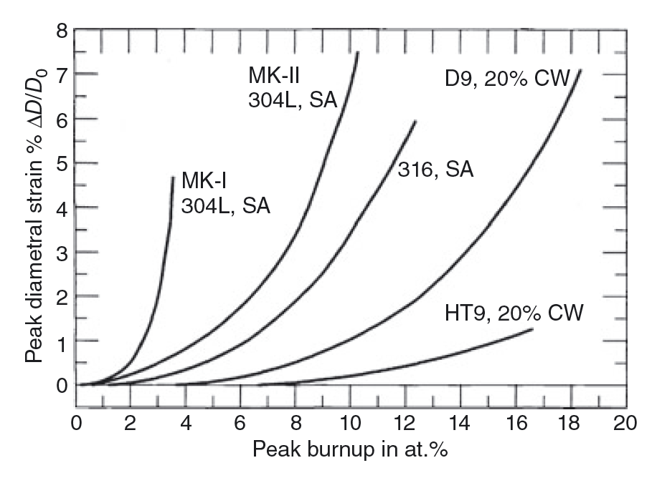
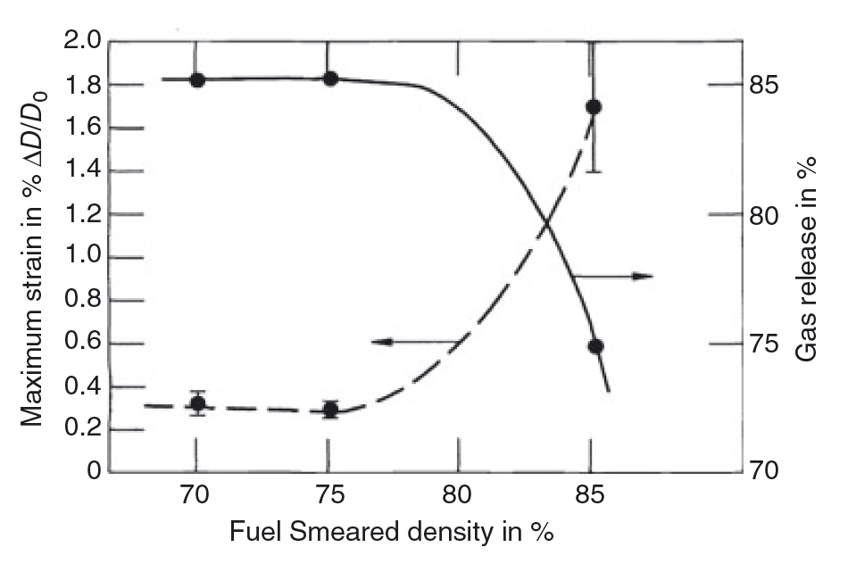
SFR Cladding
HT9 is the current cladding material of choice for SFRs
HT9 is a nonswelling ferritic/martensitic stainless steel
The rate of cladding strain has increased for the initially 85% fuel smeared density elements
12.5% BU

